Slide 1
Mobile
Demographics
By: Harsh Parikh

Slide 2

HELLO!
I AM Harsh Parikh
Data Scientist Program at Thinkful
Notes:
Slide 2: Hello and welcome. My name is Harsh Parikh, I’m a Data Scientist Student at Thinkful. Today, I will be tackling topic of User Demographics

Slide 3



Background:
Mobile Demographics?
How we view the general population based on what they do on their mobile devices

Slide 4

Objectives
Executive Summary
Data Exploration
Modeling:
Machine Learning
Clusters Analysis
Neural Networks
Results
Conclusions
Limitations
Improvements
Appendix

Slide 5
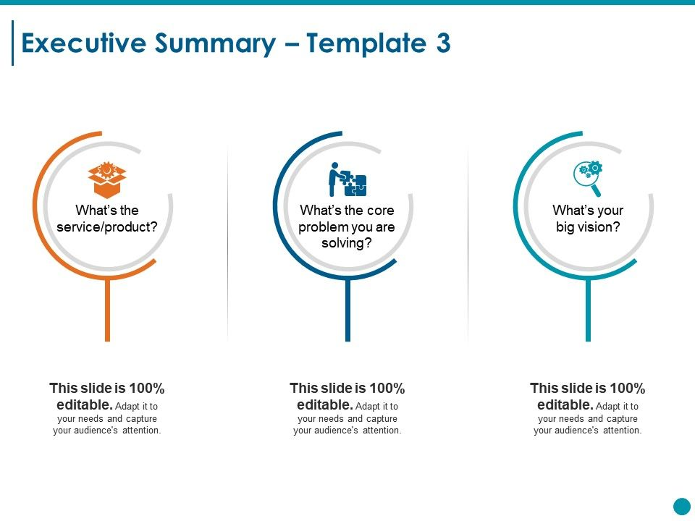

Product: Gender & Age Predictor
Uses: Advertising, Marketing,
Focus on certain markets
based off of usage data
Increase development and product efforts for specific
markets
Leverage behavioral data from more than 70% of the 500 million mobile devices to help App and Marketing Industries better understand how to interact with their audiences
Notes:
The Phone industry would benefit because we can determine if specific age groups tend to buy a specific brand or device models
Good for App Developers because we can see patterns betweens apps and downloads, and age groups
Repurpose: BG/Intro
Use Cases/Big Vision (core problem) - service product on
Split this in two.
Put a synopsis of what our objectives are. Objectives, Results

Slide 6
Methodology
Data Exploration
Modeling:
Machine Learning
Compare 3 models: Gradient Boosting, Random Forest, & K-Nearest Neighbor
using ROC-AUC Scores
Clusters Analysis
K-Means and Gaussian Mixture Modeling along with PCA and T-SNE Reductions
using Silhouette Scores
Neural Networks
3 Activation Functions (RELU, Sigmoid, & TANH) with 2 Optimizers
and compare using ROC-AUC Scores

Slide 7
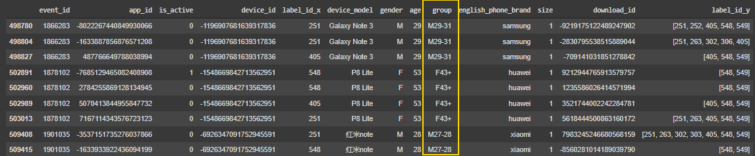
Data Exploration
See Slide 32 for more detail
Data was obtained from a Kaggle by TalkingData
7 CSV files in Dataset, all containing info about cell phone data
Age & Gender, App & Device Info, Categories, Events, etc.
BEFORE: OVER 32 MILLION ROWS, 600 COLUMNS
AFTER: 436000 ROWS, 8 columns
Sample: 16000 ROWS, 8 columns
Notes:
bull

Slide 8
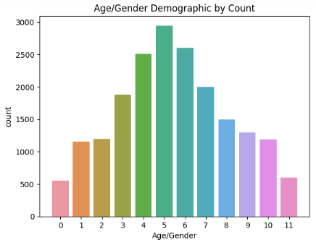
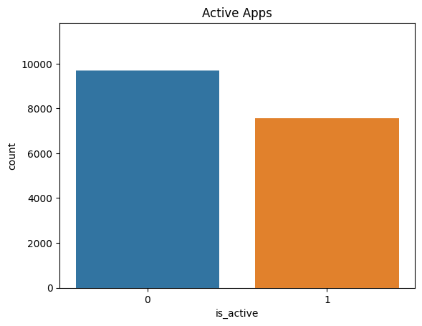
Low amount of information on 0, 1, 2, 9, 10, 11
Lacking information on all the F Groups (0-5 = male, 6-11 = female)
0 = inactive, 1 = active.
58% of the apps are inactive, while 42% are active of the sample
Notes:
Toss in appendixd

Slide 9
Machine Learning Models
3 Classification Models were implemented
Random Forest
K-Nearest Neighbor
Gradient Boosting
Each tuned with optimal parameters
2 Dimensionality Reduction Techniques were used
Select K-Best
PCA
Each Model was run through each dimensionality reduction method

Slide 10
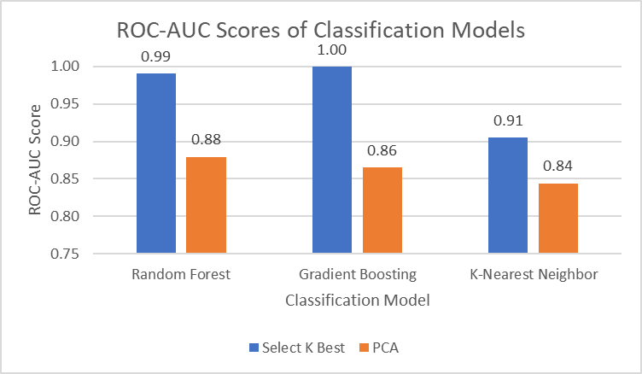
Which Model was best?
Notes:
Link excel sheet to presentation, and manipulate.

Slide 11
Random Forest
See best features/Report on slide 35
99% with Select K Best
WHY?
High Dimension Data, Better for Subsets
Random forests are a large number of trees, combined (using averages or "majority rules") at the end of the process.

Slide 12
Gradient Boosting
See best features/Report on slide 37
100% with Select K Best
Gradient boosting machines also combine decision trees, but start the combining process at the beginning, instead of at the end

Slide 13
Clustering Algorithms
K-Means and Gaussian Mixture Modeling (GMM)
K-Means: Was tuned the n_cluster parameter to include a range from 3-7
PCA Dimensionality Reduction was applied
GMM: Was tuned in n_components parameter to include a range from 3-7
T-SNE Reduction was applied

Slide 14
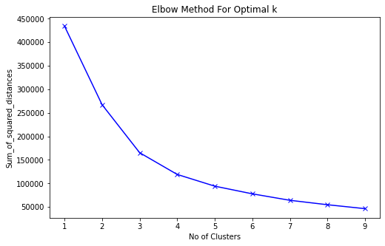
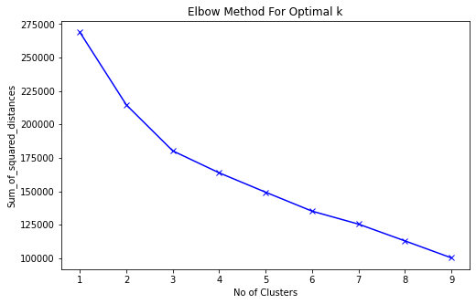
Elbow Curve
K-Means GMM

Slide 15
K-Means and PCA reduction, the scores increased as the number of clusters rose, with the highest being 0.21 silohouette score at 10 clusters.
Each cluster appeared to be relatively the same size with cluster 4 being an exception.

Slide 16
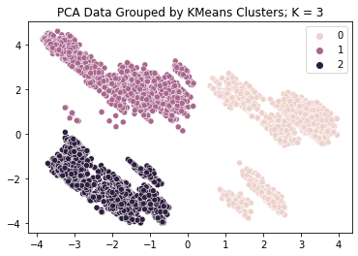
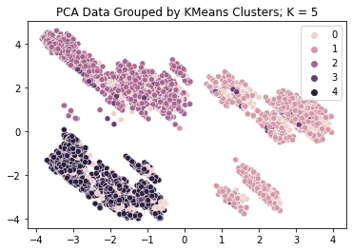
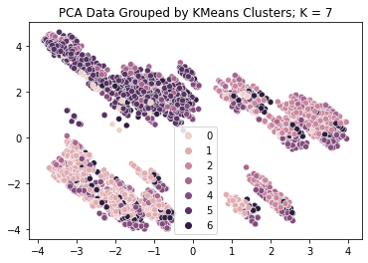
Notes:
Graphics could be appendix

Slide 17
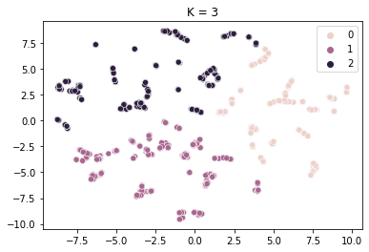
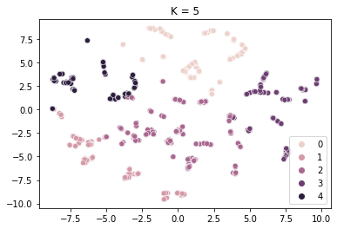
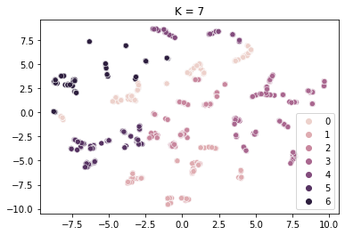

Slide 18
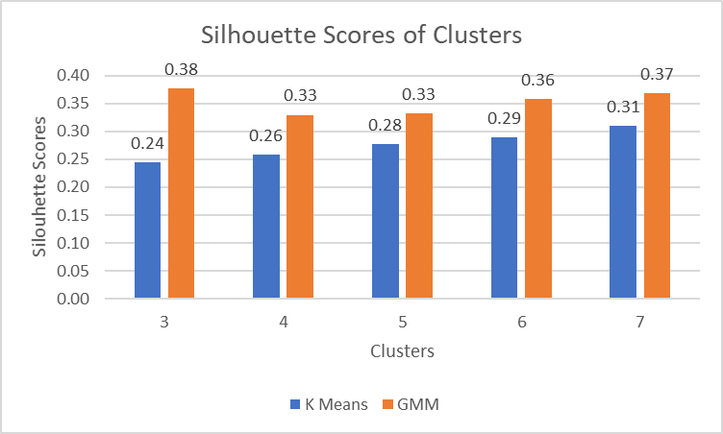

Slide 19
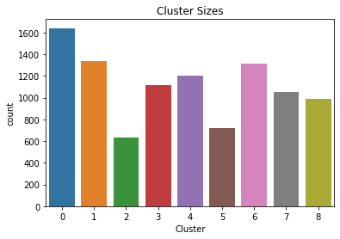
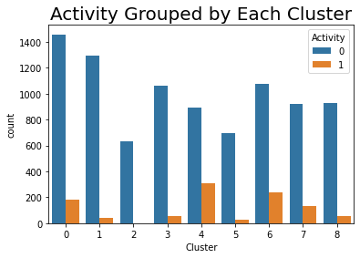
Check out appendix for more detail slides 39-41

Slide 20
Neural Network Parameter Tuning
Activation Functions:
RELU, Tanh, Sigmoid
Consistently used 3 layers
Optimizers used:
Adam
SGD
Epochs: 20, 100
Batch Sizes: 128, 64

Slide 21
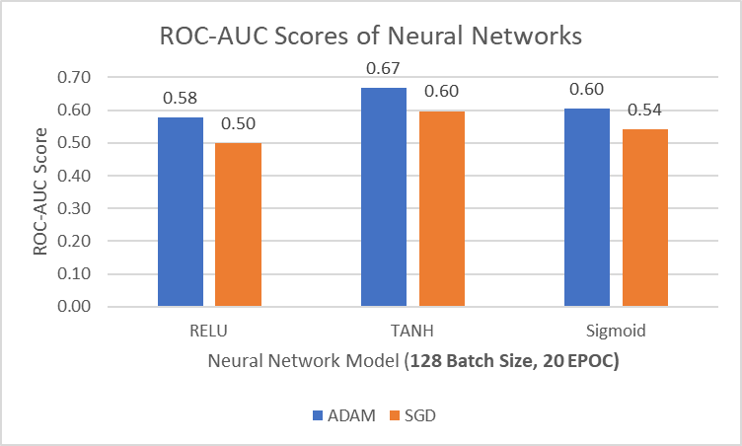

Slide 22
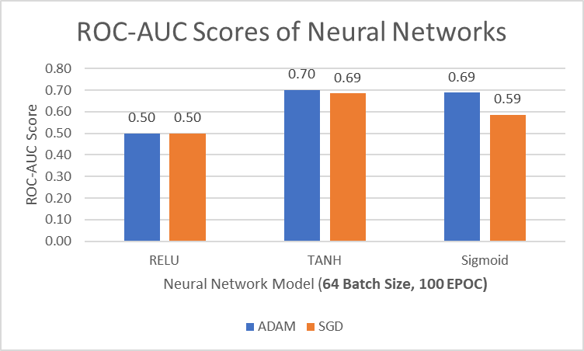

Slide 23
Neural Network Results
I used the ROC-AUC metric to to justify each model
Best Result was Tanh with Adam Optimizer at 0.70 accuracy. Increasing Epoches and decreasing batch size barely had an impact

Slide 25
Limitations
Size of data was drastically reduced, due to memory issues & time constraints
Had to implement a subsample of data and apply each modes to subsamples
Clustering
Only used 2 clustering algorithms (PCA and T-SNE)
These constraints could have an impact on the models
Neural Networks:
Only used 3 layer models
Kept Learning Rate and Momentum for loss functions constant

Slide 26
Conclusion
Target: analyze the final data frame and create multiple models to help with the Phone and App Marketing industries
Classification Models: Determined if I could accurately predict the age and gender of a group based off of their phone models, app categories, and different phone features.
Clustering: Grouped up these features to see what contributed to each group and if there were noticeable patterns within each cluster.
Neural Networks: Determine if it would provide a higher score than my supervised learning classification model
Notes:
I dropped certain features that contributed to multicollinearity and one hot encoded my categorical variables. I then used the preprocessed data frame for my models.
Supervised Learning
For my classification models, I used K Nearest Neighbors and Random Forrest Classifiers to try and predict age and gender groups. Once I obtained results from these models, I used PCA for dimension reductionality to see if my accuracy would improve. I used components that summed up to 90% variance; however, applying PCA only hurt the accuracy. After comparing the confusion matrices and classification reports for each model, I was able to determine the best model came from using a Random Forrest Classifier with the parameters:
criterion: 'gini',
max_depth: 110,
min_samples_leaf: 1,
n_estimators: 100
Due to time constraints, I had to fit these models on sub samples of the data set, therefore, the accuracy was not as high as it potentially could have been.
Unsupervised Learning
The clustering portion of this project consisted of two clustering algorithms and two dimensionality reduction methods. I used KMeans and Gaussian Mixture Modeling along with PCA and UMAP to try and group up the unlabeled data. However, similarly to the supervised learning portion of the project, I had to fit these models to a smaller subsample of the data and therefore the Silhouette Scores were harmed in the process. After testing out n_neighbors = 5, 10, 100, and 200, for UMAP, and n_clusters ranging from 3-10 for KMeans, the best Silhouette Score was obtained from using UMAP with n_neighbors = 200, and KMeans with 6 clusters. Each cluster appeared to be relatively the same size with cluster 0 being an exception. It was difficult to find certain patterns within each cluster, but I believe had I performed the clustering on the entire data set, more patterns would be evident.
Neural Network
When creating the neural network model, I used three different activation functions:
RELU
Tanh
Sigmoid
Each model only consisted of three layers, however I used two different optimizers for each model:
Adam
SGD
Once I was able to determine which activation function and which optimizer provided the best results, I had increased the amount of epochs from 20 to 50 to finally 100. Increasing the epochs did not impact the accuracy of the classification model.

Slide 27
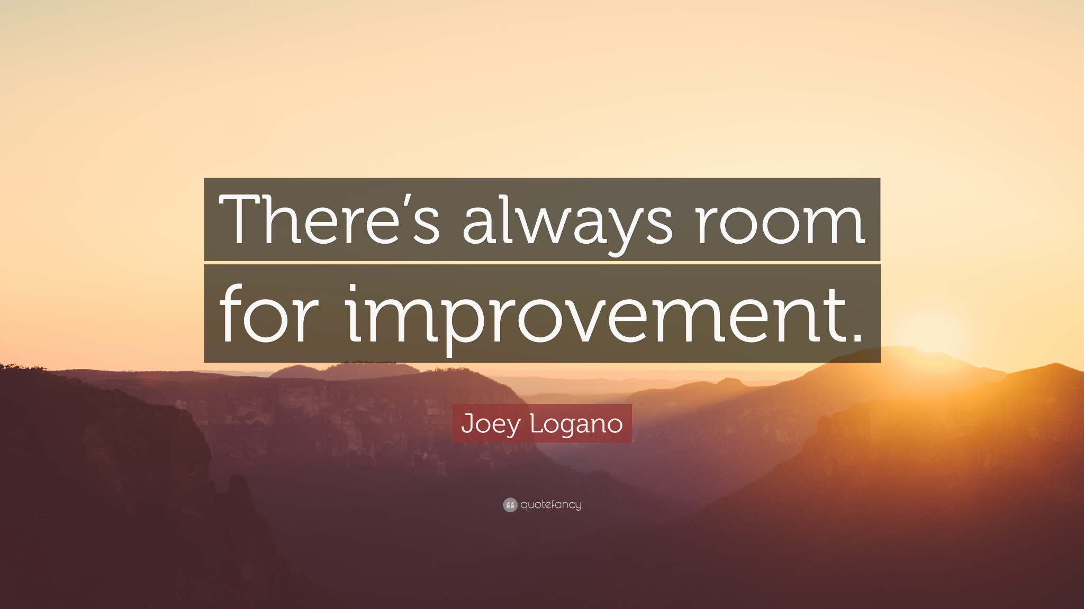

Slide 28
Recommendations
Fit entire data set for supervised and unsupervised learning models
Incorporate Umap for unsupervised learning models
Tune momentum and learning rate in loss functions
Have more modern data for Post COVID, as Data I use is from 2017 (I think results are vastly different now compared to then)

Slide 29
THANKS!
ANY QUESTIONS?

Slide 30
CREDITS
TalkData’s Kaggle Dataset
Presentation template by SlidesCarnival
Photographs by Unsplash
MathPlotLib for Graphs
Full Research Report by Harsh
Google Images for Pictures

Slide 31
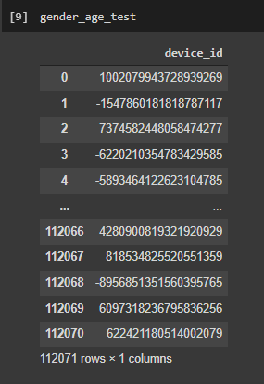
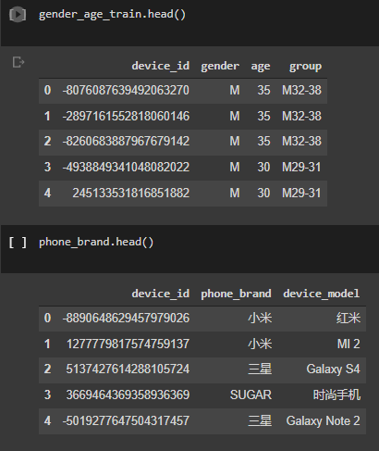
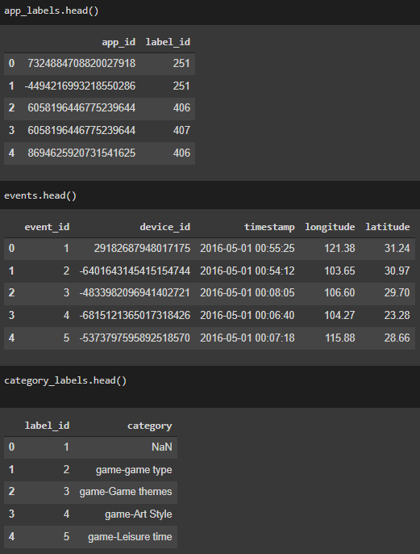
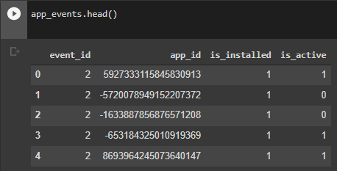
Appendix 1: Data

Slide 32
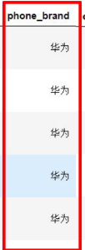
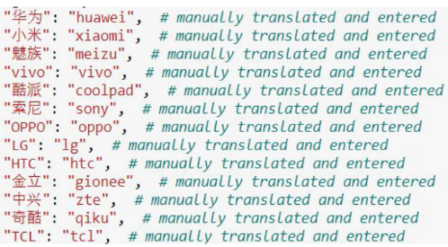
Appendix 2: Data Cleaning
32 million rows → 4.5 million rows

Slide 33
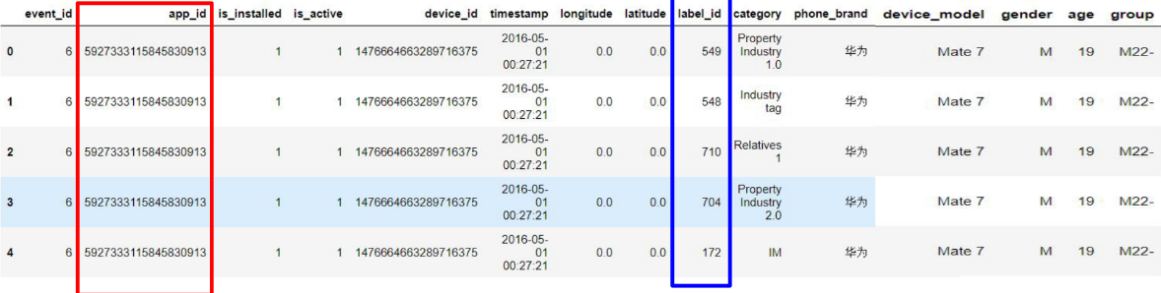
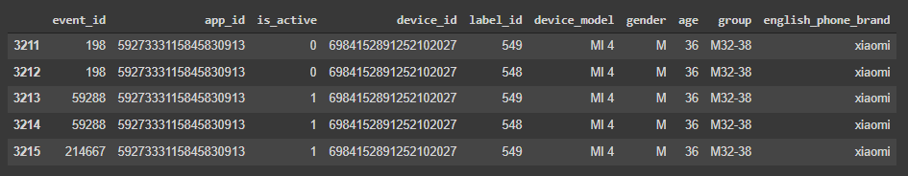
Appendix 3: Data Cleaning

Slide 34
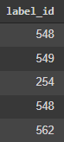
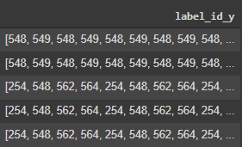
Appendix 4: Data Cleaning
Notes:
Did one hot encoding on all of them when we applied it to our data

Slide 35
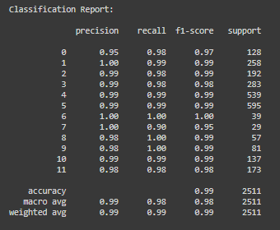
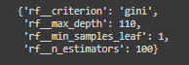
Random Forest Results

Slide 36
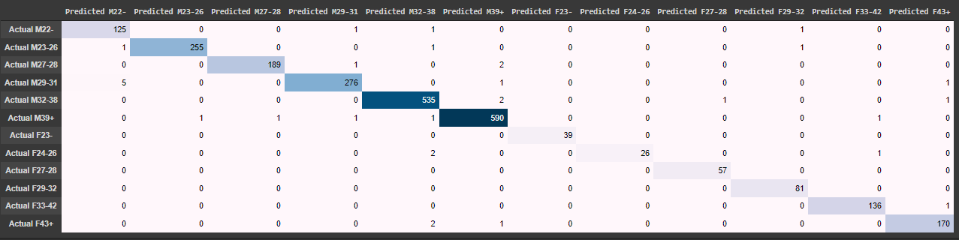
RF Matrix

Slide 37
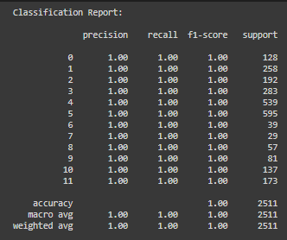
GB Results
Notes:
What am I looking at.

Slide 38
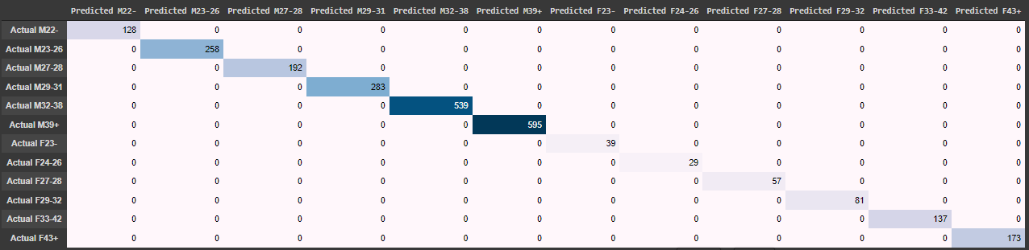
GB Matrix

Slide 39
Clustering Activity Counts

Slide 40
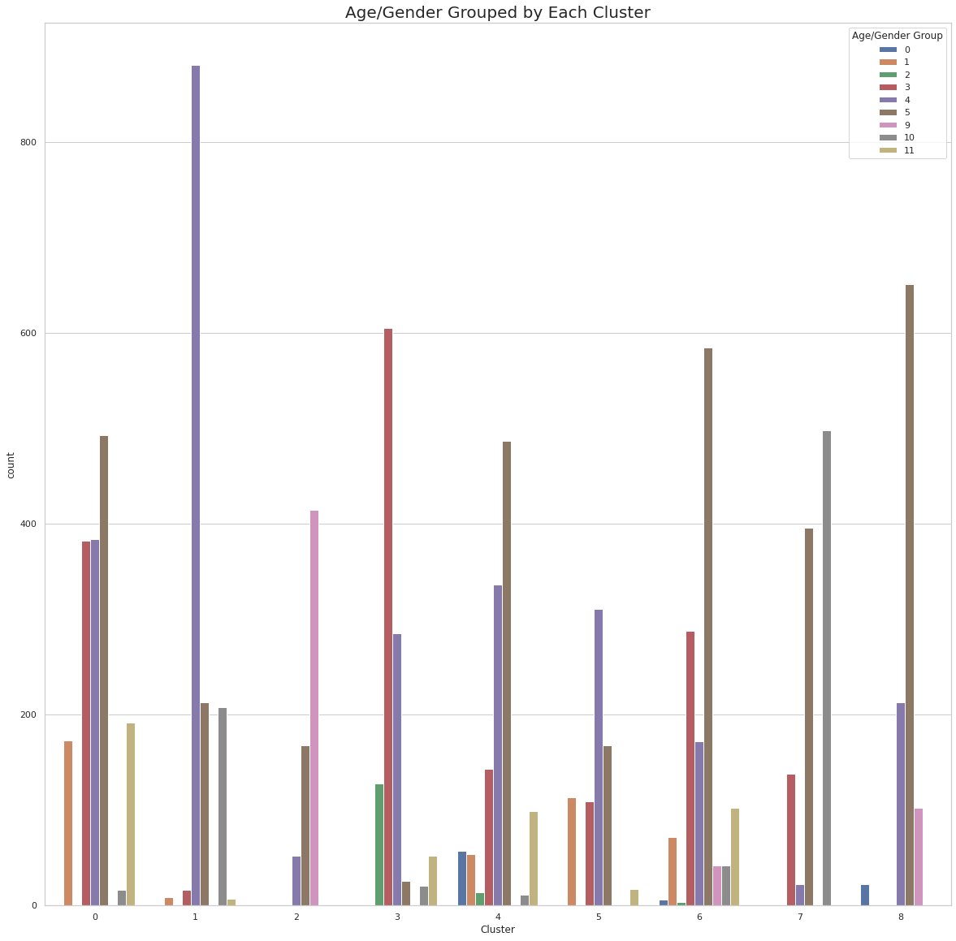

Slide 41
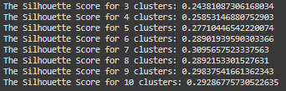
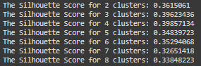
Clustering Outputs
PCA/K-Means
T-SNE/GMM

